Slide 1

Real-estate
Innovtech

Slide 2
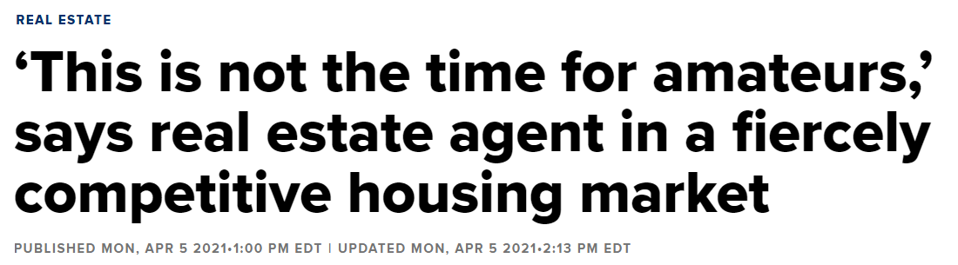
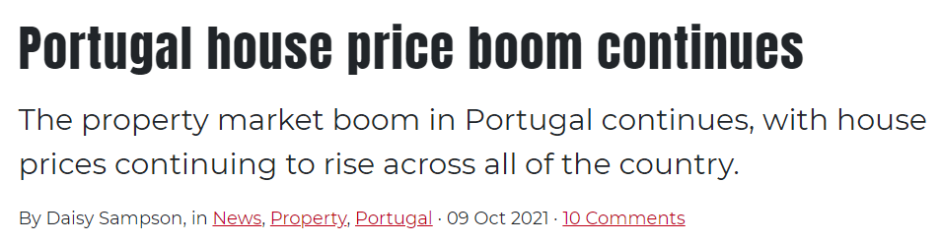

Slide 3
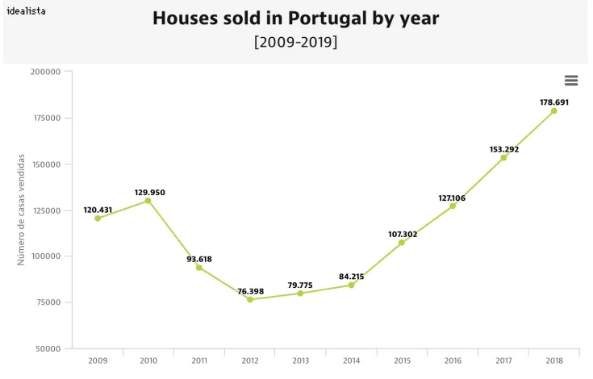

Slide 4

Rise in competition
There are 6800 real-estate agencies in Portugal
Difficulty
Covid / More clients
Precision & Time saving
Price
Data base of potential clients
Let them going to you
Make your business growth

Slide 5
Nearest neighbors
We will be using unsupervised machine learning algorithm, Nearest neighbors
What it does
This algorithm will predict the best price to sell a house with the specifics inserted
How it works?
It will do these predictions based on data we have on average prices in the area, square feet, number of rooms, etc etc

